Slide 1


Slide 2
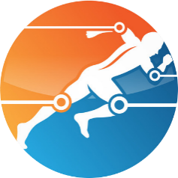

Final Year Project
Smart Rehab
Supervised by:
Imran Raza
Co-Supervised By:
Dr. Asad Hussain
Session: 2016-2020
Acknowledgement:
Funded by Higher Education Commission
(HEC)

Slide 3

Group Members
Imtisal Ahmed
Arslan Riaz
FA16-BCS-045
FA16-BCS-081

Slide 4
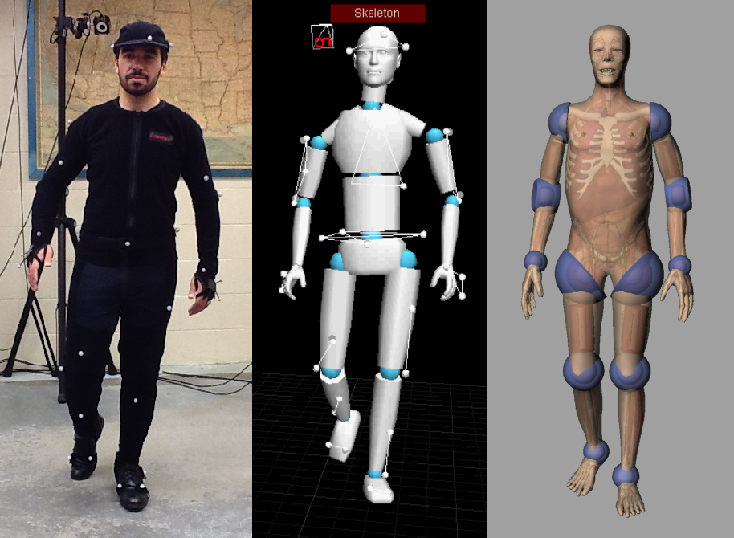
Motion Capture
Motion capture (referred as mo-cap or mocap) is the process of recording the movement of objects or people. It is used in medical application, military and for validation of computer vision and robotics etc.

Slide 5
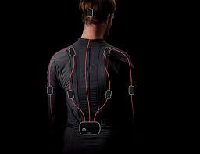
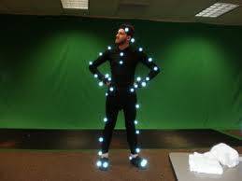
Types of Motion Capture
IMU sensor Based
Optical
Inertial Measurement Unit (IMU) sensors are a technology capable of estimating orientation of a rigid body so they are largely used as an implementation of real-time motion capture systems to track the location and the body posture of people.
Optical Motion Capture systems use data acquired from image sensors to localize the 3D position of a subject among multiple cameras which are calibrated to provide overlapping projections.

Slide 6
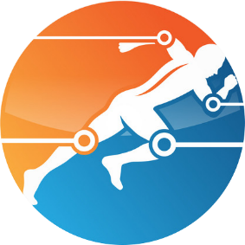
Smart Rehab
Smart Rehab, an assistive system for Physiotherapists based on motion capture for the identification and rehabilitation of Parkinson's Disease patients. It is a complete desktop application that helps in the identification and rehabilitation of Parkinson’s disease patients.
Smart Rehab

Slide 7
Objectives
1
2
3
Automate the analysis of major factors in Parkinson’s disease i.e. gait and posture analysis for early diagnosis and assistance in rehabilitation by assessing real-time tracking of each body joint using IMU sensors.
Assess the motor dysfunction in patients based on the MDS-Unified Parkinson's disease rating scale to help boost the rehabilitation process.
Assist the doctors with continuous performance tracking and measuring the range and agility of each body joint in real-time

Slide 8
Objectives
4
5
6
Identify delicate changes in the patient’s disorder progression, and to evaluate the efficiency of rehabilitation in a consistent way.
Provide a 3D virtual avatar to replicate the patient's body motion in real-time to give visual feedback.
Implement a cost-effective and efficient system.

Slide 9
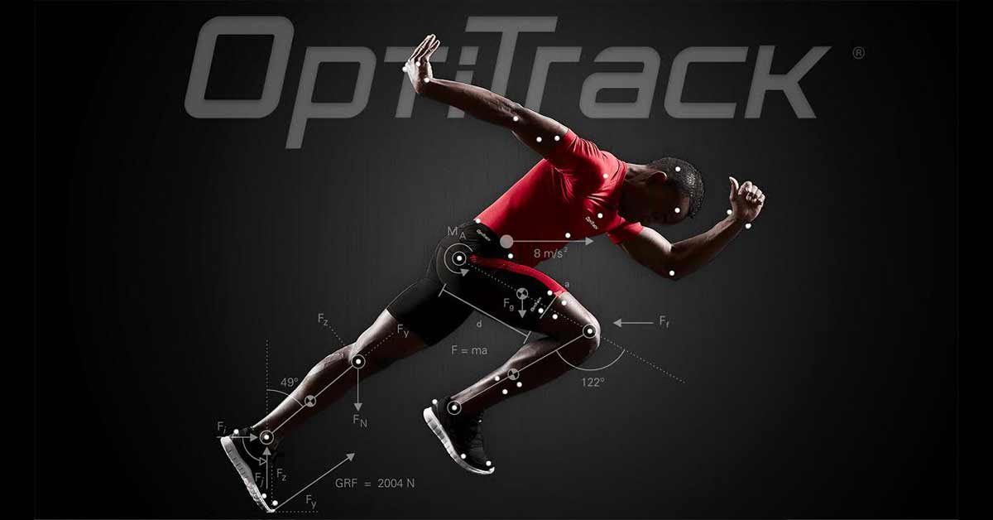
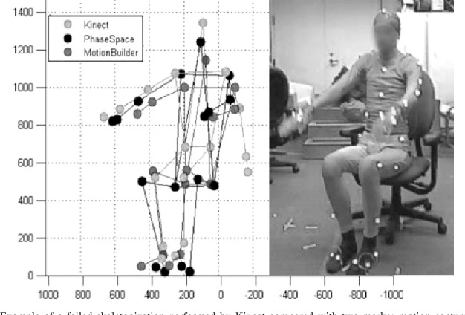
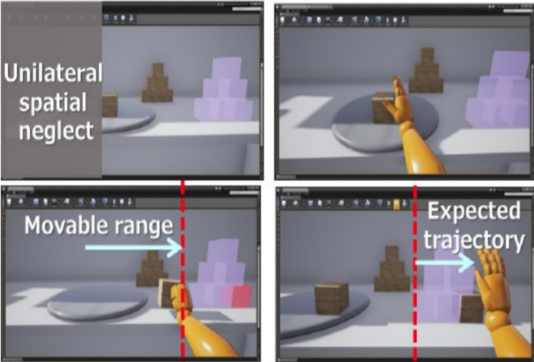
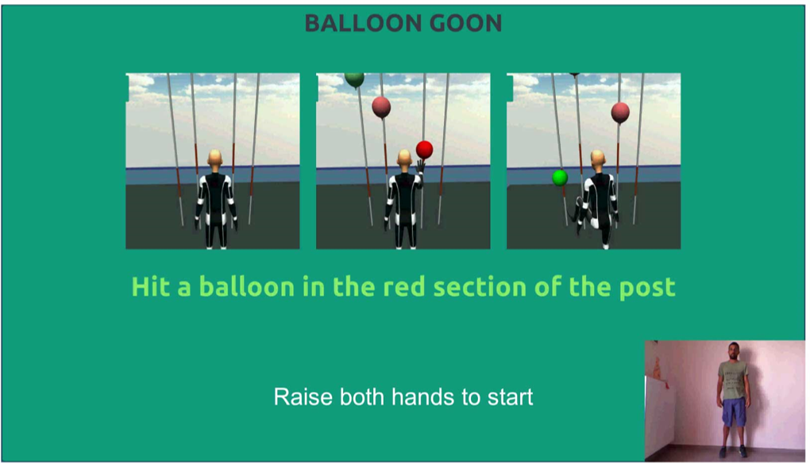
Related Work
sports performance analysis [1]
Motor Rehabilitation using Kinect [2]
Leap motion controlled video game-based therapy[3]
Rehabilitation assistance using Virtual Reality [4]
Kinect Based Exergames for Parkinson’s Patients [5]
Biofeedback for Neuromotor Rehabilitation [6]

Slide 10
Problem Statement
Parkinson's disease is a nervous system disorder. According to Neurology Awareness & Research Foundation (NARF) Pakistan, a rough estimate is that 1 million Pakistanis suffer from Parkinson’s disease, moreover an estimated 10 million people worldwide have Parkinson’s disease. In spite of its high prevalence globally, no authentic early diagnostic system is yet available for its early diagnosis. Owing to this reason, there is a great need to design a smart diagnosis system for diagnosing this disease in its early stages Even though Parkinson's disease can't be cured, but exercises can improve the range of body movement a lot. However, the conventional physiotherapy treatments are available but the maneuvers and exercises physiotherapy offers are quite dull, dreary and less engaging to the patient so the patient tends to lose interest which in turn hinders their prognosis of the rehabilitation process. Thus, this creates a massive need to establish an assistive system that will assist the physiotherapists in replacing the dull and boring exercises into interactive and engaging tasks

Slide 11
Challenges
Virtual Frame Filling
Data Collection
1
When we record animations as the data is gathered through wireless medium so some frames are not captured properly and need to be filled virtually after the recording while processing.
3
As the technology is new in this field so gathering a large amount of data to train and test machine learning algorithm is challenging as finding large number of patients for a substantial amount of time is difficult.
Height Profile
2
As height and body measurements of each individual vary so suit needs to be configured every time a new user uses it.

Slide 12
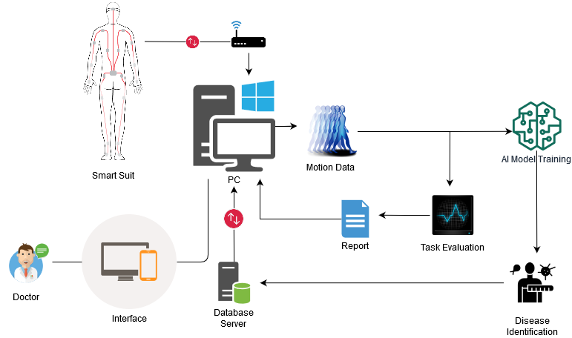
System Design

Slide 13
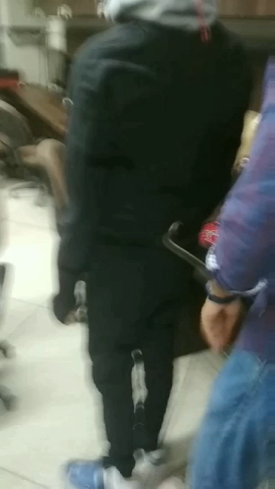
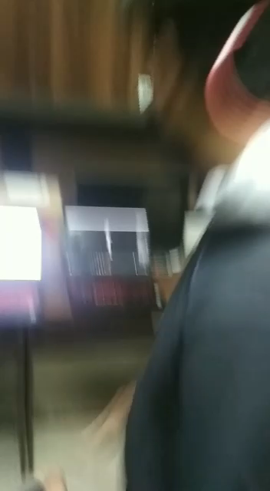
System Design(Cont.)

Slide 14
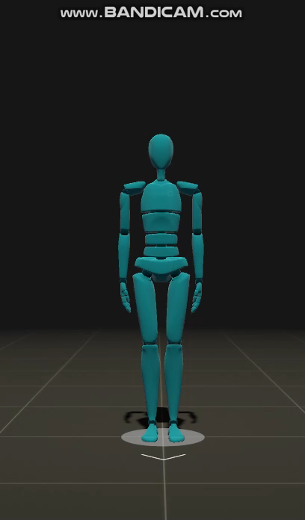
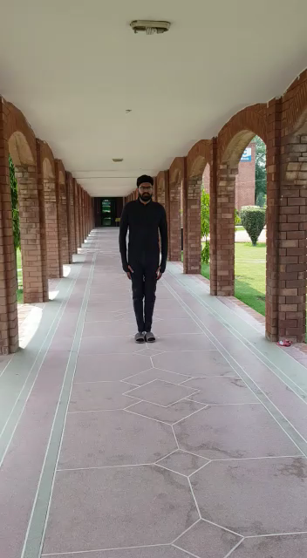
System Design(Cont.)

Slide 15
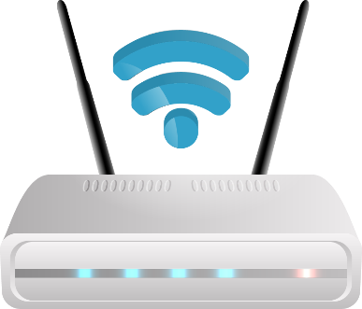
Hardware Used
01
Rokoko Smart suit Pro
02
WIFI Router

Slide 16




Software & languages
Unity3d
For Software Development Frontend/backend.
Rokoko Studio
For Animation and Task Creation.
C#
Language used in Unity3D for software Development.
Python
For Machine learning Algorithm.

Slide 17
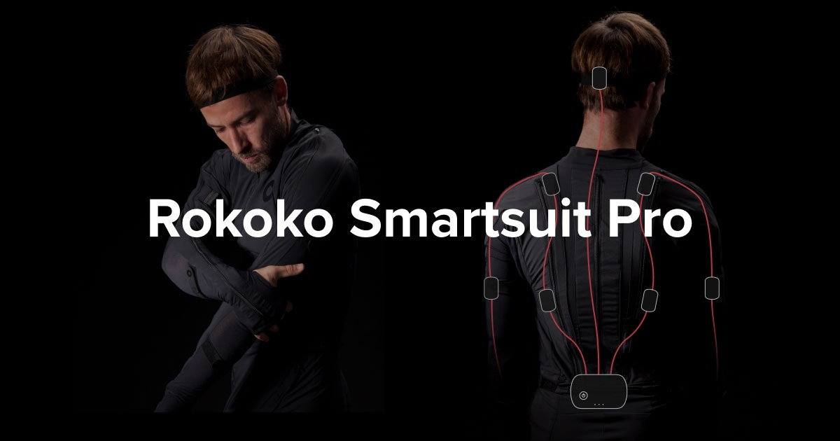
Rokoko Smart suit Pro
19
1
100
19-DoF Inertial Measurement Unit Sensors
WIFI and USB 2.0 Communication Onboard memory Smart Hub
Up to 100 meters of wireless range

Slide 18
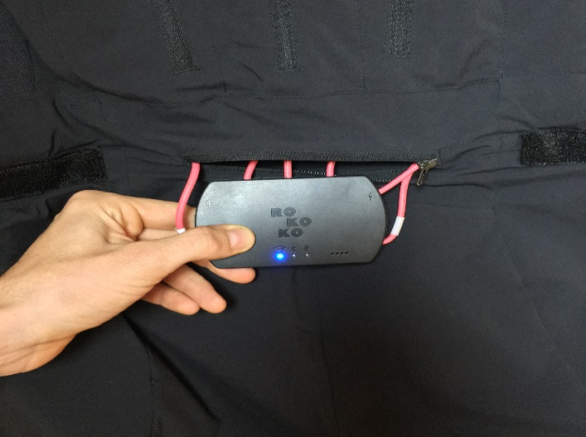
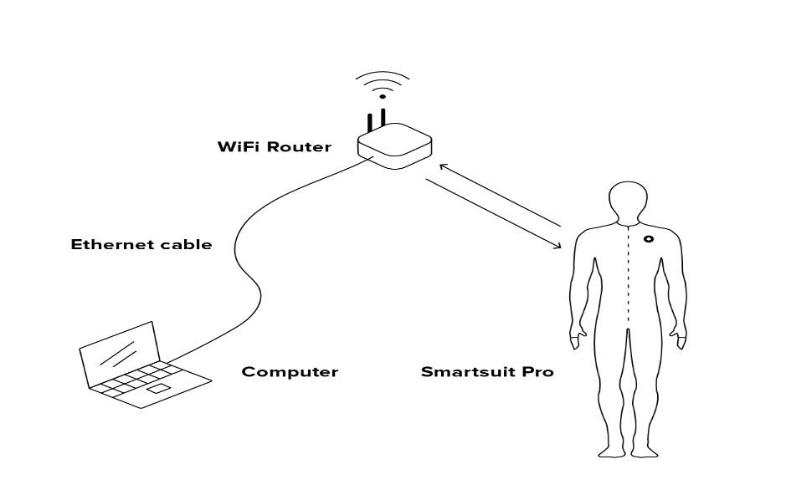
Smart Suit Pro Connection/Configuration
First Step
Second Step
Third Step
Fourth Step
Smart suit pro hub WIFI mode Connection with Dedicated WIFI Router
01
Receiver Laptop/Pc Connection with the same dedicated WIFI Router
02
Smart suit pro Configuration
03
Creating a Data bridge connection between Receiver Laptop and Smart suit for Data transfer
04

Slide 19
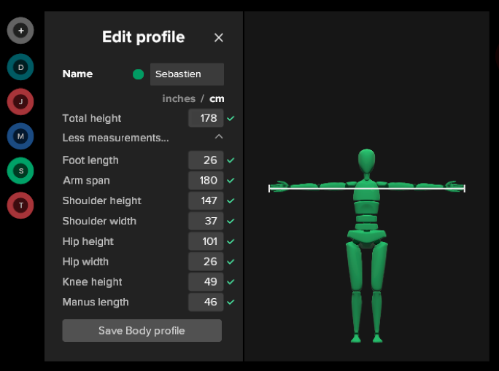
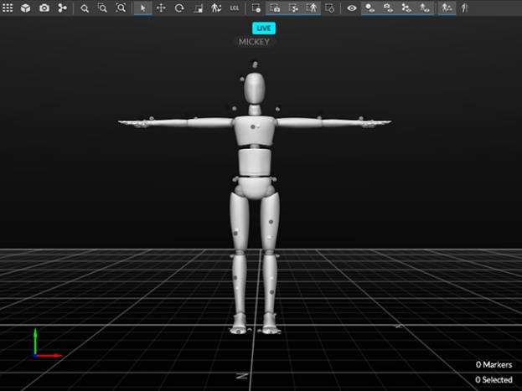
Model Calibration
First Step
Second Step
Third Step
Fourth Step
A 3D Humanoid avatar is calibrated according to the user’s Height profile and body measurements
01
The calibrated model is then Configured in T pose To get exact Posture.
02
Current Position of the model is set as root position
03
Model is Calibrated on the root position which will serve as the starting position and reference for getting motion data.
04

Slide 20
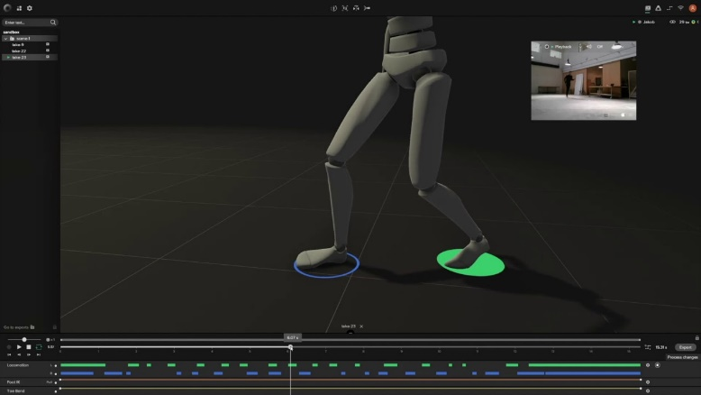
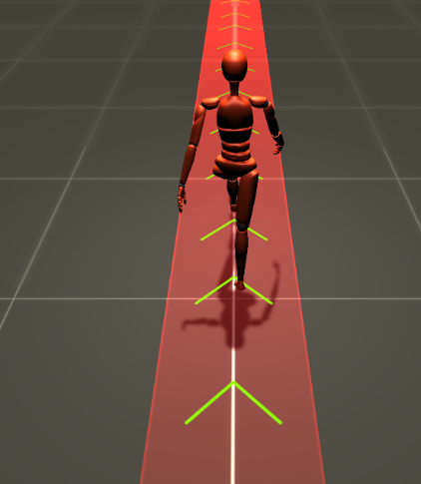
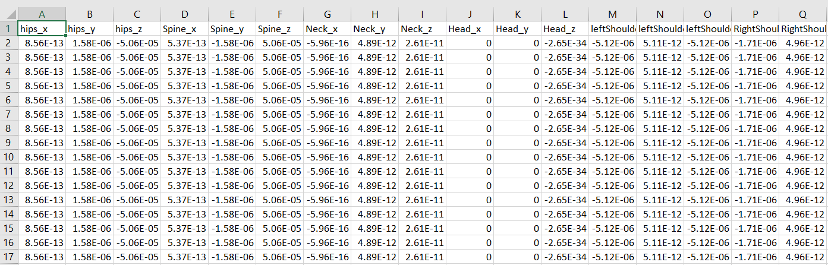
Animation Recording
First Step
Second Step
Third Step
Fourth Step
Healthy Person performs Exercises wearing the Smart Suit pro Configured/Calibrated Properly
01
The motion data of that healthy person’s motion is collected and stored in a file
02
That data is then processed and lost frames are filled virtually
03
The processed data is imported in Unity 3D to create animation of Task which would be performed by Patient
04

Slide 21
Realtime Task Performance
First Step
Second Step
Third Step
Fourth Step
A unity plugin is made to get real time data from the smart suit pro
01
Real time height profile of user is calibrated on a 3D avatar
02
3D Avatar is placed is a task performing environment in unity 3D
03
Realtime task is performed and motion data of that task is collected and stored in a file
04

Slide 22
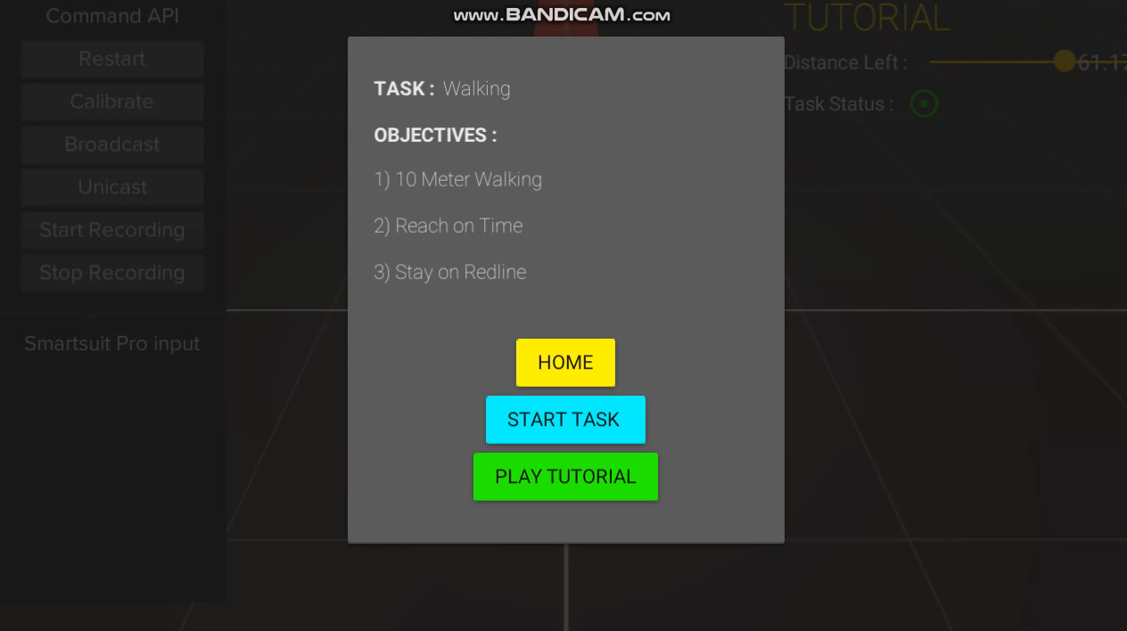

Slide 23
Comparison & Report Generation
First Step
Second Step
Third Step
Fourth Step
Motion data of both Healthy person and patient are stored in one file
01
Data of both the files is processed and made useable for the algorithm
02
Mathematical Formulas are applied on the processed data and a detailed report is generated
03
Detailed report of the patients body joints movement is fetched and displayed to the doctor to assess it and make further decisions
04

Slide 24
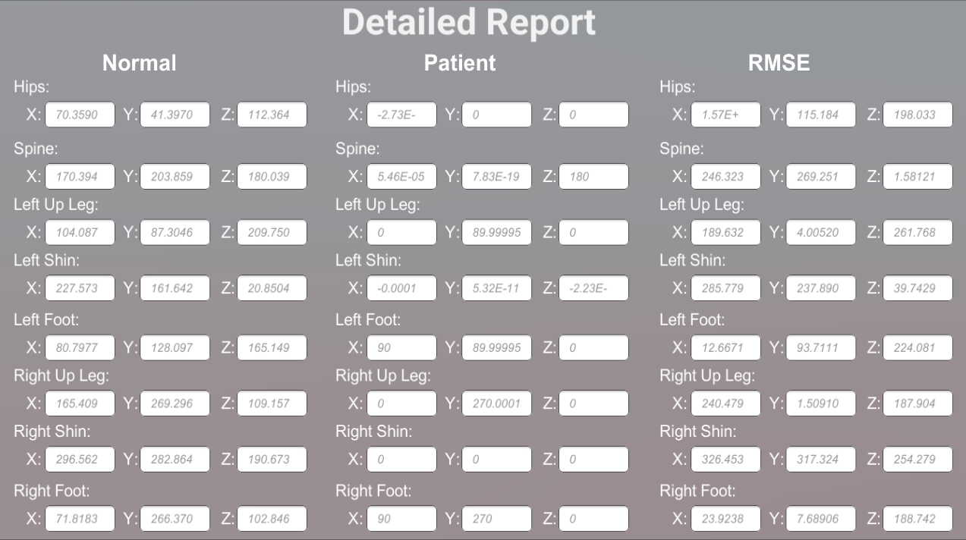

Slide 25
Identification & Machine Learning
First Step
Second Step
Third Step
Fourth Step
Motion data of patients is collected and labeled for Classification
01
Machine Learning Algorithm is trained on the labeld data
02
An ML model will be created for the assistance in identification of Parkinson’s disease
03
The system will assist doctor in identification of Parkinson’s disease by assessing patients real time motion data
04

Slide 26
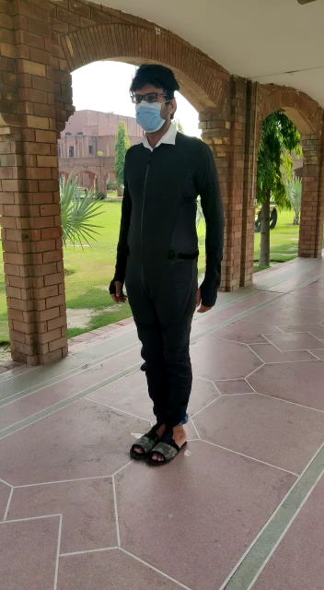
Data Acquisition
1
Motion Data of a person wearing Rokoko Smartsuit Pro is collected Using IMU Sensors.
2
IMU sensors in the Smartsuit obtain data with respect to some root position in 3 Dimensional Plane. Obtained Attributes are
Position
Rotation
Velocity
Acceleration

Slide 27
Data Acquisition(Cont.) (Healthy Person)

Slide 28
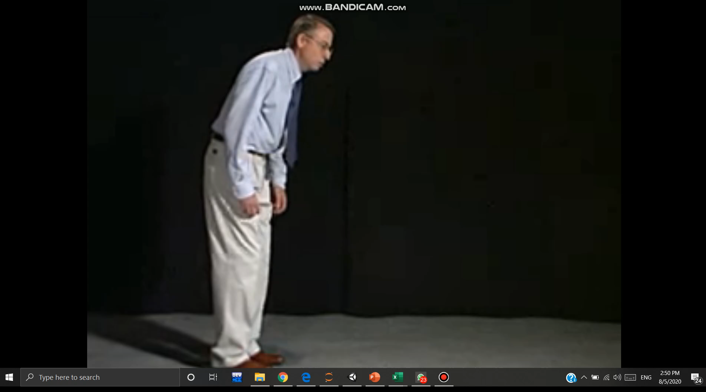
Data Acquisition(Cont.) (Patient)

Slide 29
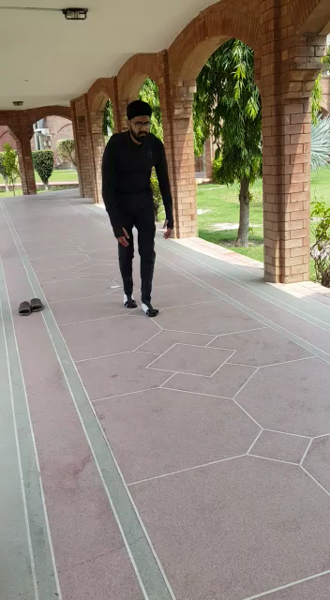
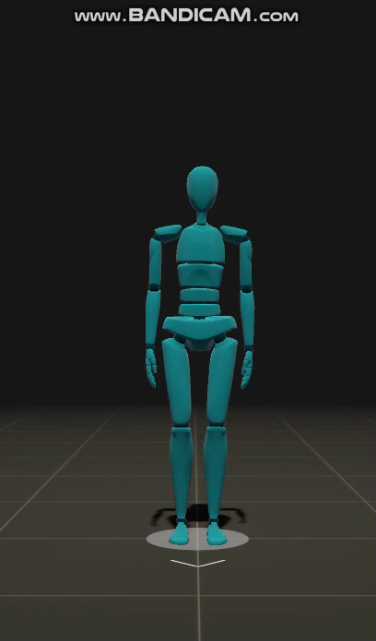
Data Acquisition(Cont.) (Patient)

Slide 30
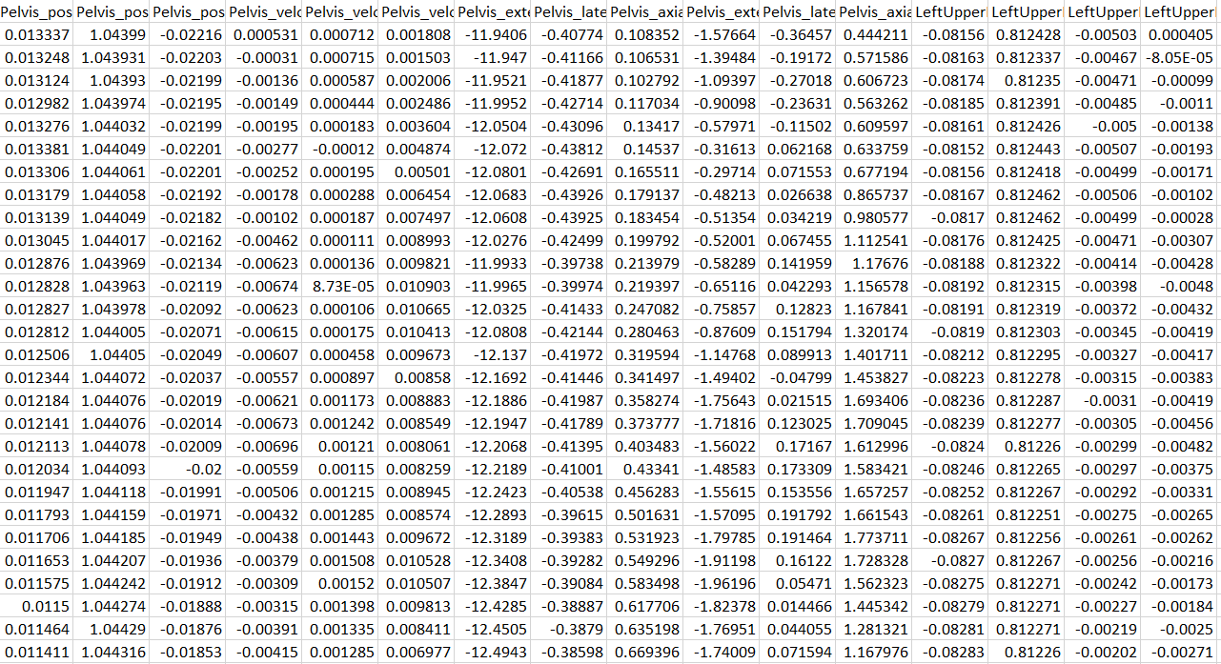
Data Acquisition (cont.)
1
Motion Data of a person wearing Rokoko Smartsuit Pro is stored in the form of CSV.

Slide 31
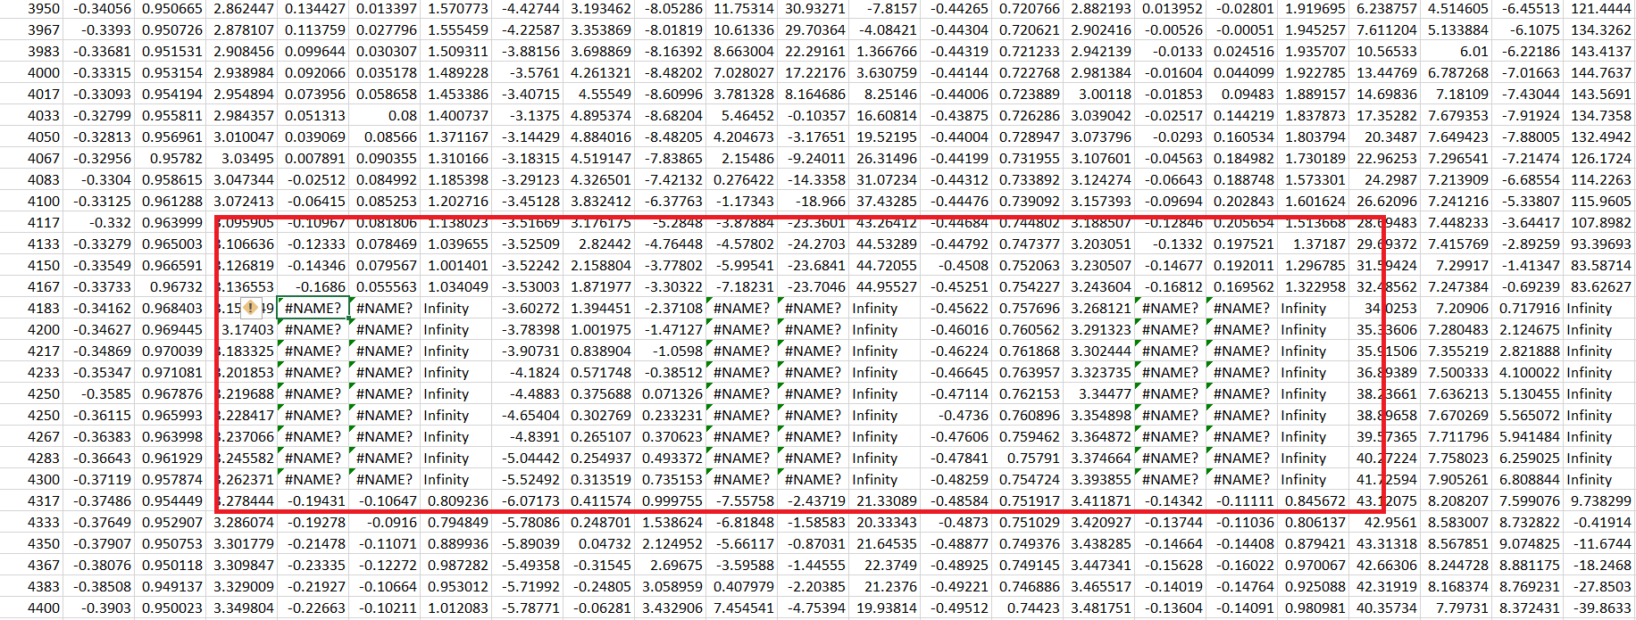
Data Preprocessing
1
Data Acquired Via smartsuit pro has some ambiguities .
So the data has to under go some preprocessing.

Slide 32
Data Preprocessing(Cont.)
1
Preprocessed Data

Slide 33
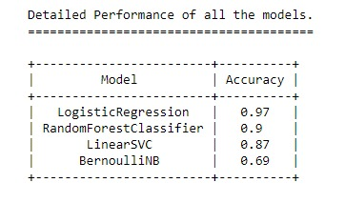
Model Training
1
Models Trained
Logistic Regression
Random Forest Classifier
Linear SVC
Bernoulli NB
2
Selected Model
“Random Forest”
Logistic Regression was overfitted as its accuracy score was high but it performed poorly in application phase so we used Random Forest.

Slide 34
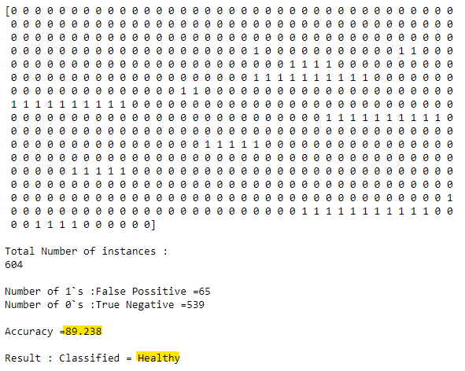
Results

Slide 35
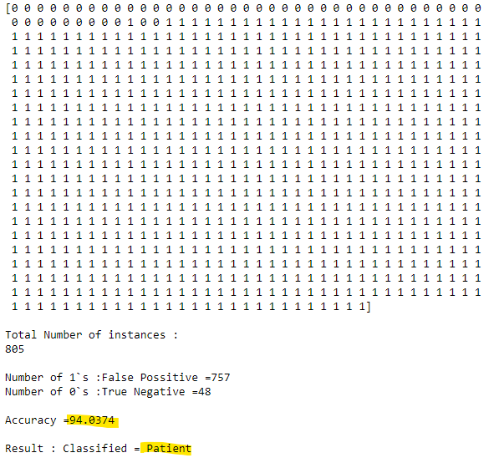
Results(Cont.)

Slide 36
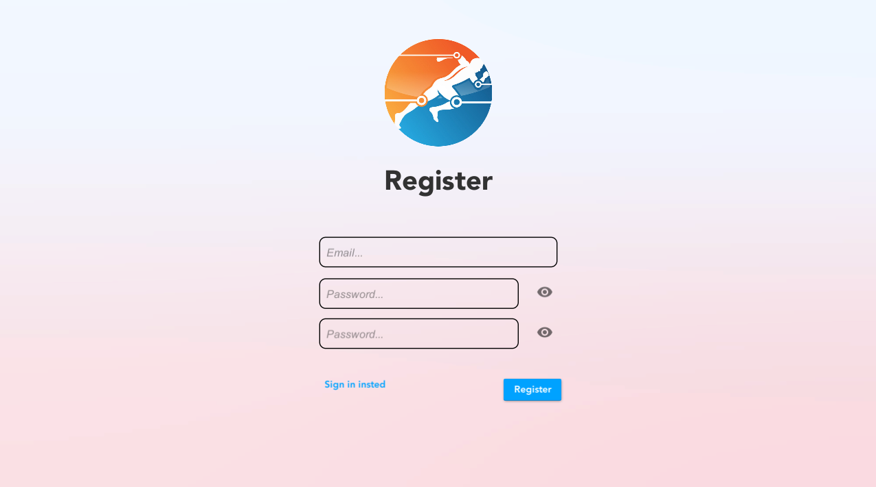
Authentication/Authorization
1
Signup
Doctor Sign Up, Doctor can sign up by putting his email and Password.

Slide 37
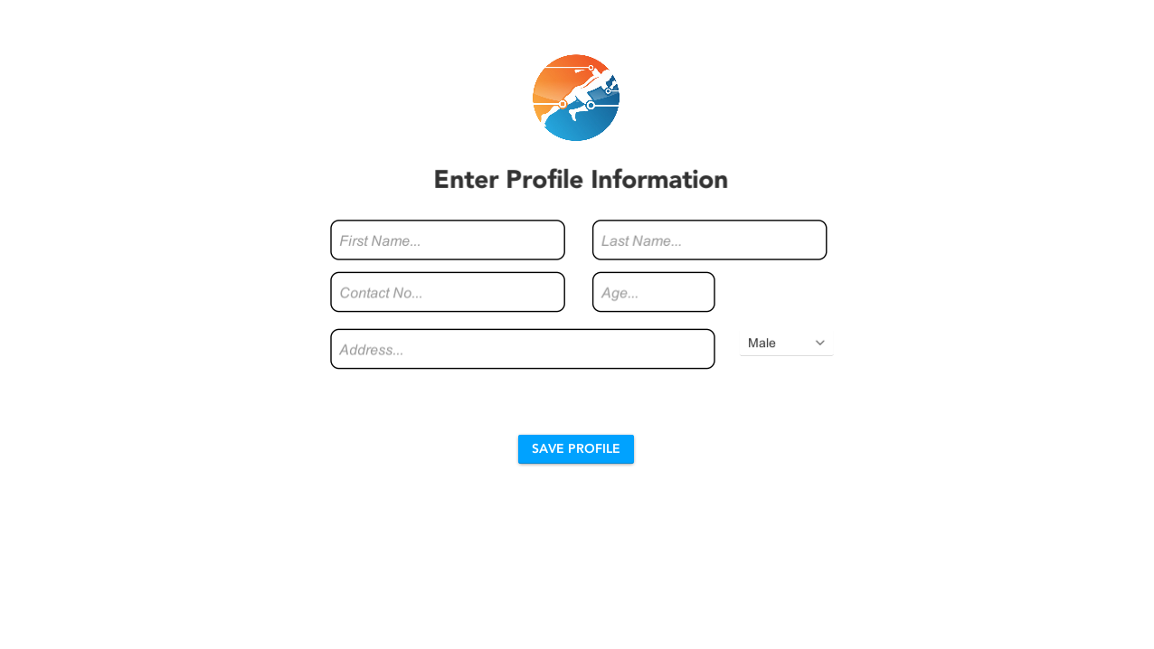
Authentication/Authorization
1
Add Profile Info
After Sign up an add profile screen will appear where Doctor will add his profile Information.

Slide 38
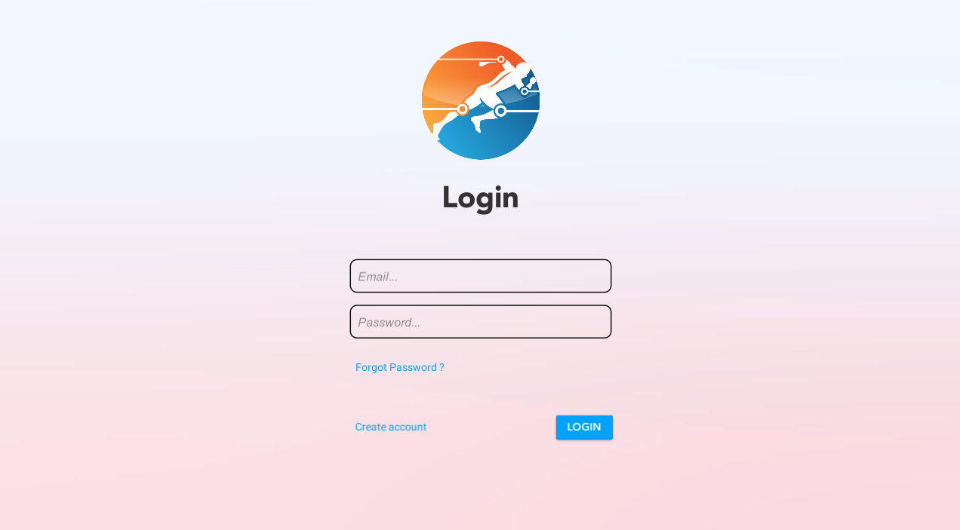
Authentication/Authorization
1
Login
A login screen for doctor where he/she would put their login credential to access the system
2
Forgot Password
A forgot Password button in case the doctor forgets his/her login credentials.
3
Create New
A create new profile button if the doctor is a new user and does not have a profile.

Slide 39
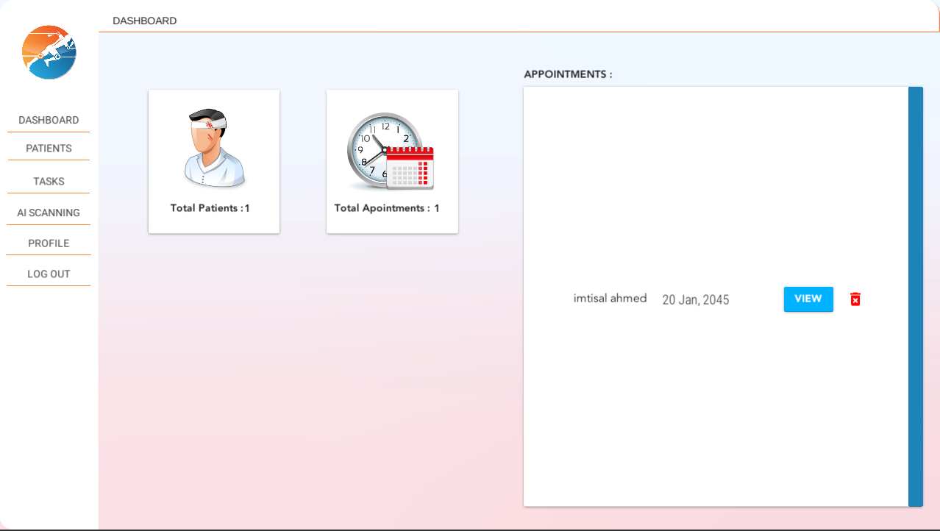
Doctor Module
1
Dasboard
A dashboard panel where doctor would have a overall summary such as Total Number of Patients, number of appointments and Active appointments.
2
Sidebar
A side bar with all the quick access buttons of other panels

Slide 40
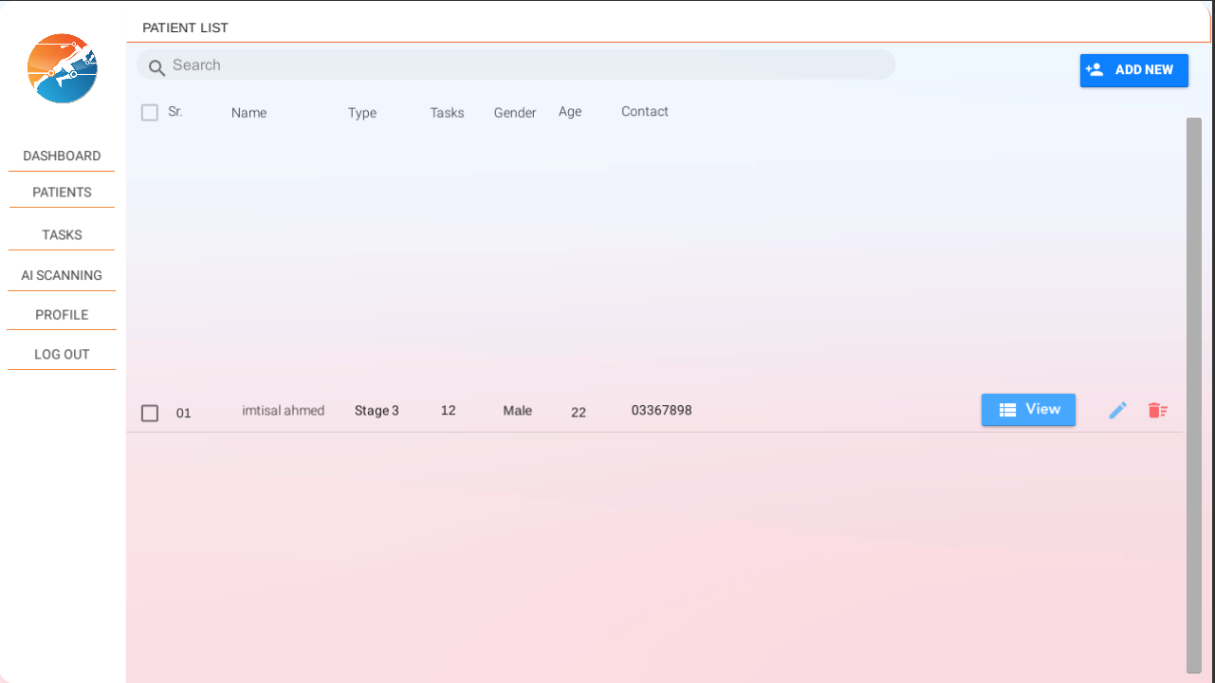
Doctor Module
1
Patients List
A panel where doctor can see all of his patients in a list view from which he can select CRUD functions on selected patient.
2
Add New
An add new patient button for doctor to add a new patient.

Slide 41
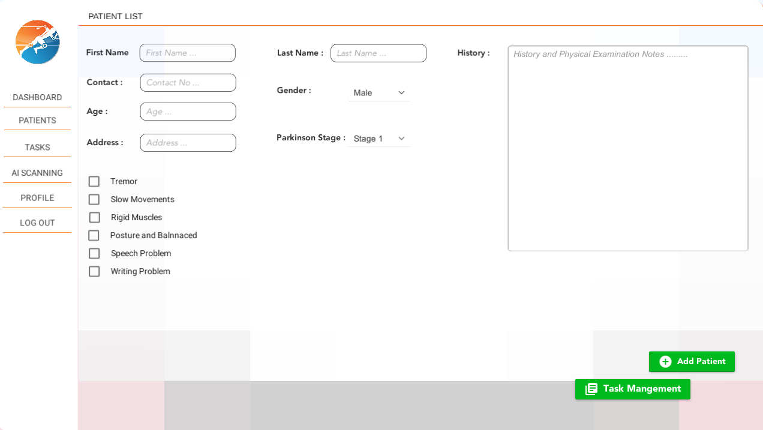
Doctor Module
1
Add Patient
An add patient screen Where doctor would add information about a new patient,
2
Task Management
Task management button to open task Plan for the patient screen.

Slide 42
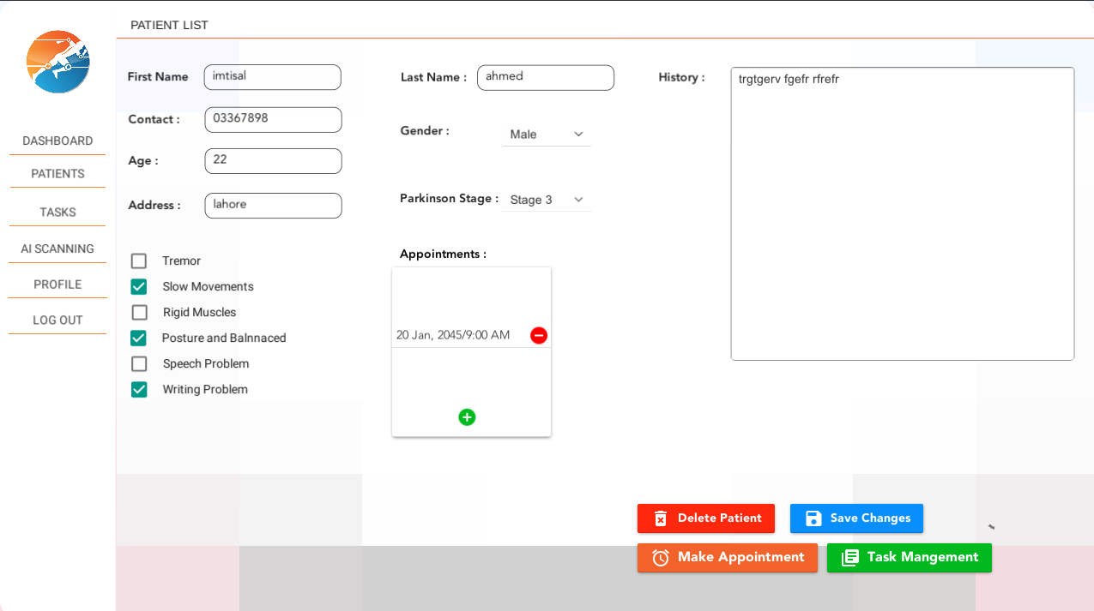
Doctor Module
1
View Patient
A view patient window where Doctor can see the profile of a patient and all his Information
2
Make Appointment
A make appointment button for adding new appointments.

Slide 43
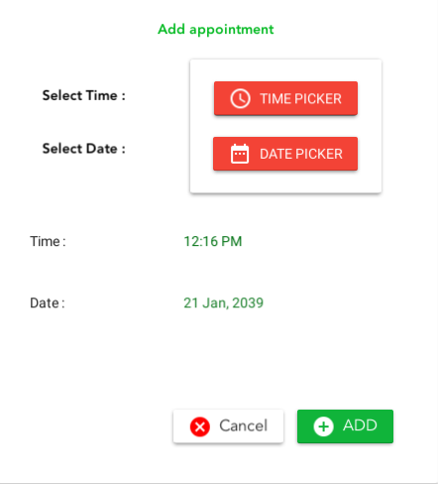
Doctor Module
1
Add Appointment
An add Appointment Window for doctor to add new Appointments.

Slide 44
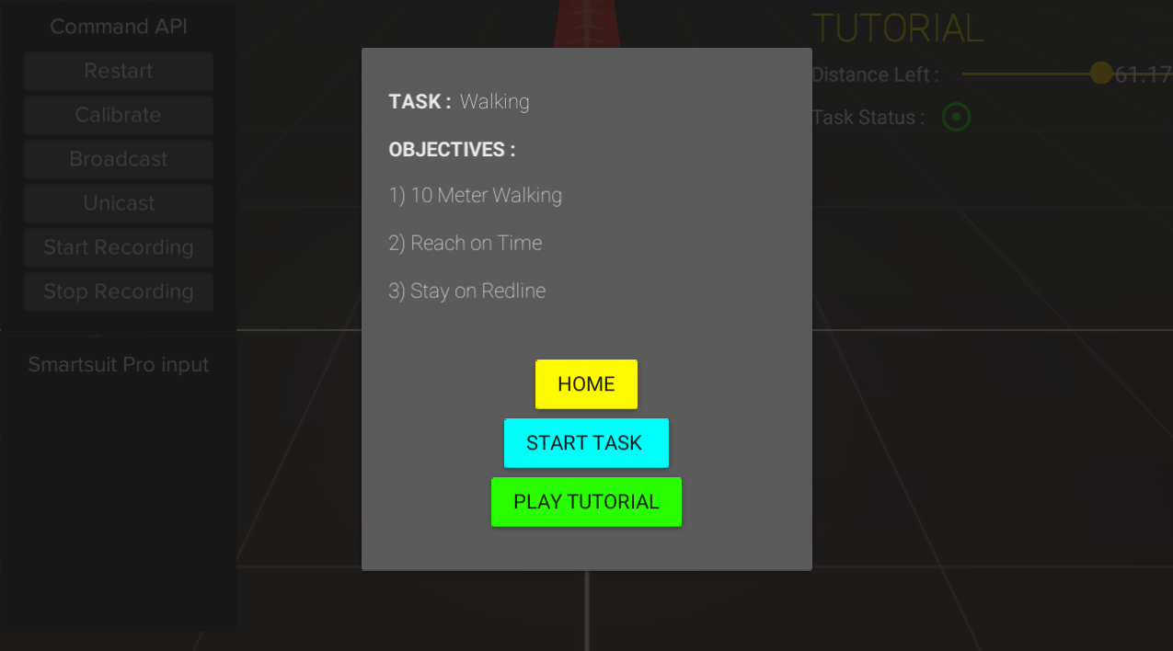
Rehabilitation Module
1
Start Task screen
A start task panel for doctor to Start Patients Task Selected from the patient’s task plan
2
Start Tutorial
Start Tutorial button for starting tutorial animation for patient to watch and learn
3
Home Button
A home button for going back to the patient management window

Slide 45
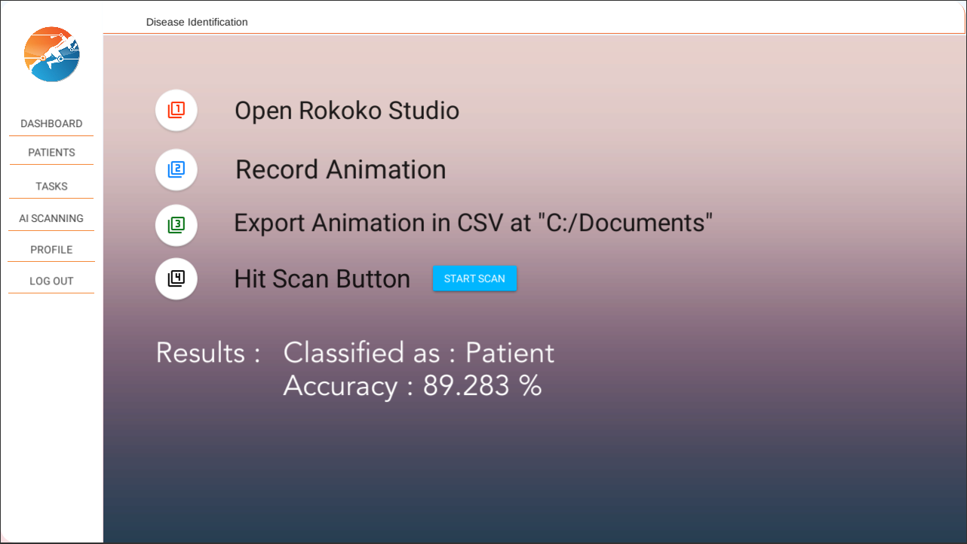
Identification Module
1
Open Rokoko Studio
Doctor needs to open rokoko studio
2
Record Animation
Doctor needs to record animation in rokoko studio
3
Export csv
Doctor needs to export csv to documents folder
4
Scan/Results
Doctor needs to press scan button and results will be displayed

Slide 46
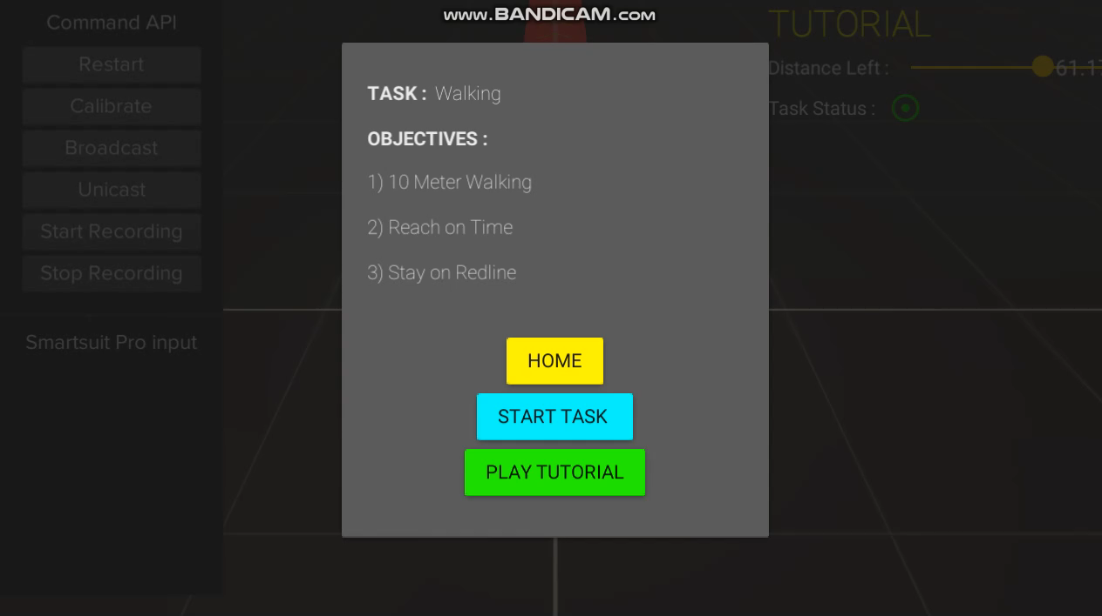
Rehabilitation Module
1
Timer Window
A timer Window before the tasks starts so patient may get ready.

Slide 47
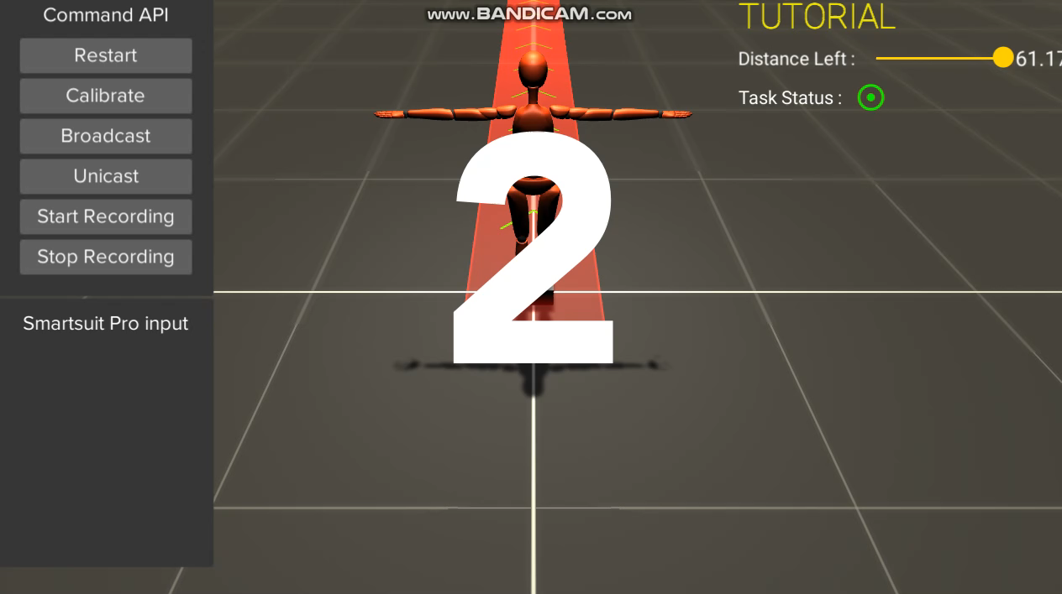
Rehabilitation Module
1
Task Tutorial
Task tutorial for patient to watch and learn from it about performing the task

Slide 48
Rehabilitation Module
1
View Panel
A view Task window where patients will see themselves performing the selected task

Slide 49
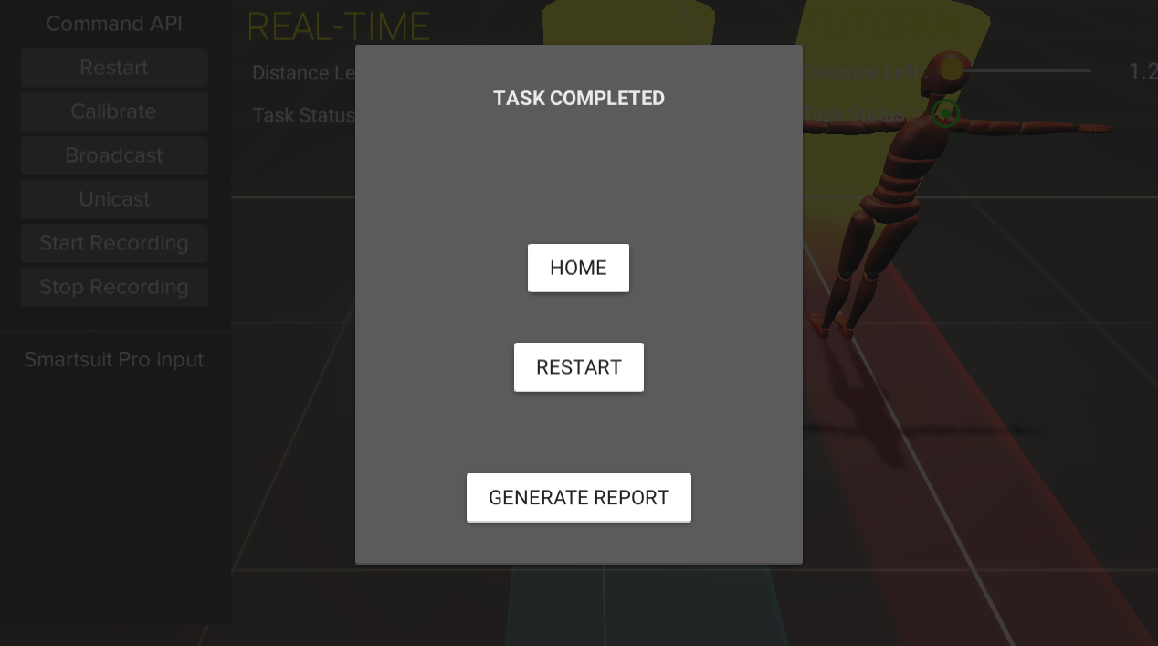
Rehabilitation Module
1
Task Completed
A task Completion Panel which will show when patient completes the Task
2
Generate Report
Generate Report Button which will Generate A detailed Report of Patients Task performance.
3
Restart
A restart button to start the task again to perform it again.

Slide 50
Report

Slide 51
Work Distribution
Interface UI/UX & Frontend
Backend & Database
01
02
Imtisal Ahmed
Arslan Riaz
Animation & Realtime motion Tracking
Comparison & Report Generation
03
04
Arslan Riaz
Imtisal Ahmed
Data Acquisition, Model Deployment and Model Integration
Data Preprocessing & Model Training
05
06
Imtisal Ahmed
Arslan Riaz

Slide 52
Work In Progress
1
Patient Portal
A portal for patients to view their reports and rehabilitation progress.
2
Future Prediction
System will suggest doctor which tasks to pursue next for that specific patient.

Slide 53
References
[1] “Motion capture systems to see how athletes’ body movements” from https://www.researchgate.net/publication/314879089_Application_of_motion_capture_technology_for_sport_performance_analysis accessed on 16 May 2020.
[2] “Intention to help in the engagement of patients on various therapies using Microsoft Kinect” from https://www.semanticscholar.org/paper/Motor-Rehabilitation-Using-Kinect%3A-A-Systematic-Gama-Fallavollita/90fe2333ff0fed80d342337f9c242bf5a81d9d2b, accessed on 16 May 2020.
[3] “Leap-motion based video game therapy for Parkinson`s patients” from https://www.researchgate.net/publication/281292319_A_Vision-Based_System_for_Movement_Analysis_in_Medical_Applications_The_Example_of_Parkinson_Disease , accessed on 16 May 2020.
[4] “Rehabilitation Assistance Using Motion Capture Devices and Virtual Reality Feedback” from https://www.scientific.net/AMM.888.37 , accessed on 16 May 2020.
[5] “Kinect Based Exergames for Parkinson’s Patients” from https://www.hindawi.com/journals/ijcgt/2018/2618271/ , accessed on 16 May 2020.
[6] “Biofeedback for neuromotor rehabilitation” from https://jneuroengrehab.biomedcentral.com/articles/10.1186/1743-0003-3-11, accessed on 16 May 2020.
[7] “Patient Gait Demostration” from https://www.youtube.com/watch?v=yhj1PktNA1c&feature=youtu.be, accessed on 16 May 2020.

Slide 54
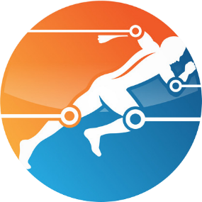
THANK YOU !

